Slide 1
help desk technique
it’s a challenge

Slide 2
Point of Contact
The Help Desk is often the first point of contact for most callers.
Good telephone techniques are critical.
Talking to callers on the phone is not as easy as it seems.

Slide 3
Be Prepared To
get in the zone
relax
be conscious
listen (carefully)
leaping to conclusions not allowed
let the customer say what they need to say
evaluate the situation
ask questions
take your time

Slide 4

How Do I
get in the zone
Prepare Your Body
Sit up, take a deep breath and relax
Prepare Your Voice
Have water handy
Be conscious of the tone of your voice
Speak slowly and clearly and be courteous

Slide 5

How Do I
listen (carefully)
Don’t interrupt a caller
most people simply want to be heard
Wait
even if you’re sure of the answer... wait until all info is presented
Ask questions
make a note of the answers so customers don’t have to repeat

Slide 6

How Do I
evaluate the situation
Urgency
give the caller options if an issue is urgent and there is no quick fix
It’s okay
to take your time to thoroughly resolve an issue
Follow-up
keep the caller in the loop on the status of an issue

Slide 7
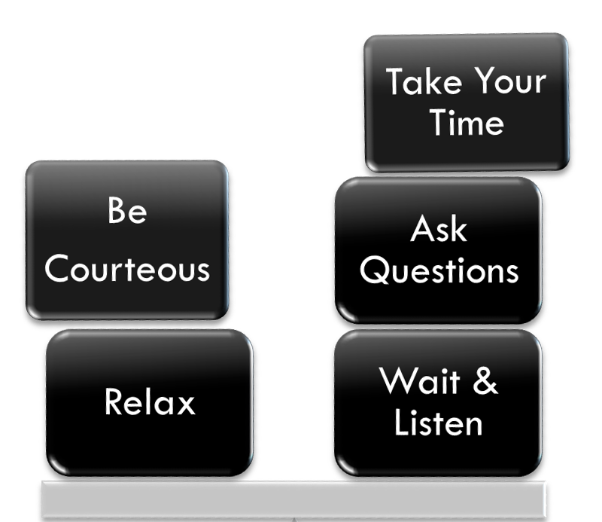
Remember
Customer Satisfaction
It’s a Balancing Act!

